Slide 1
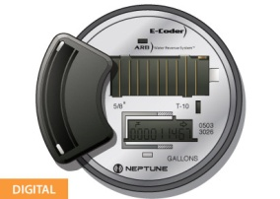

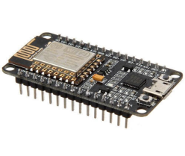





Digital Water Meter
Email Triggered
IBM Cloud Platform
MQTT
Node MCU
JEEVAN Dashboard
ARIMA Model

